Slide 1


EEE 203
Electronic Devices and Circuits & Pulse Tech
Course Instructor
Topic: MOSFET
PRESENTED BY
Samayun Miah Chowdhury (222015031)
Lusain Nima
Lecturer
Green University of Bangladesh

Slide 2
Table of Contents
CSE 303-CSE(181)
EEE 203
Introduction of MOSFET: Types of MOSFET Advantages of MOSFETs: Disadvantages of MOSFETs: Type of MOSFET : V-I Characteristics N-Channel Enhancement MOSFET N-Channel Enhancement MOSFET V-I Characteristics N- channel Depletion MOSFET: P-Channel MOSFET Applications of MOSFETs: | 3 4 5 6 7 8 9 10-16 17 18
Page: 2

Slide 3
EEE 203
Introduction of MOSFET
Page: 3

Slide 4
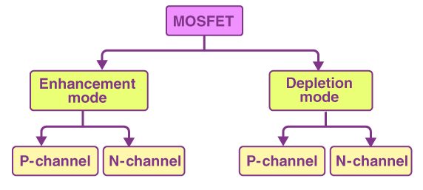
EEE 203
Types of MOSFET
Page: 4

Slide 5
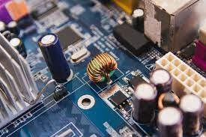
EEE 204
Advantages of MOSFETs:
High input impedance: The gate of a MOSFET is insulated from the channel, which means that it has a very high input impedance. This makes MOSFETs ideal for use in circuits where the input signal is weak.
Low power consumption: MOSFETs can operate at very low power levels, making them ideal for use in battery-powered devices
.
Scalability: MOSFETs can be made very small, which makes them ideal for use in integrated circuits.
Page: 4

Slide 6
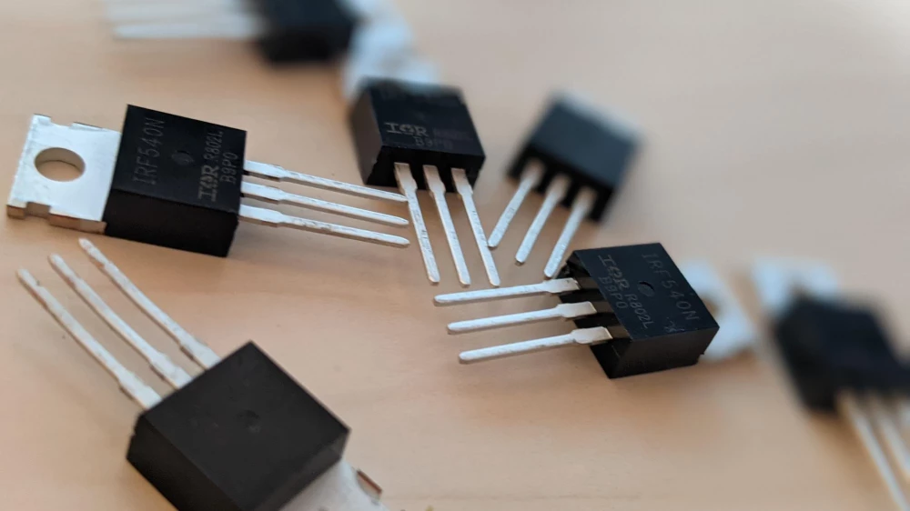
EEE 204
Disadvantages of MOSFETs:
Sensitivity to static electricity: MOSFETs are sensitive to static electricity, which can damage them.
Higher cost: MOSFETs can be more expensive than other types of transistors, such as bipolar junction transistors (BJTs).
Page: 4

Slide 7
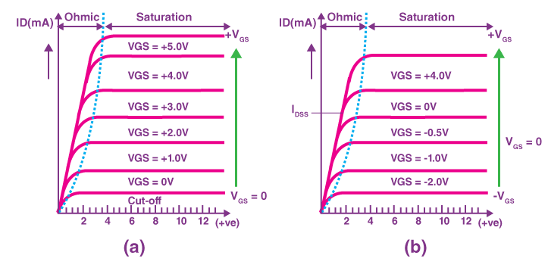
EEE 203
Type of MOSFET : V-I Characteristics
Page: 5

Slide 8
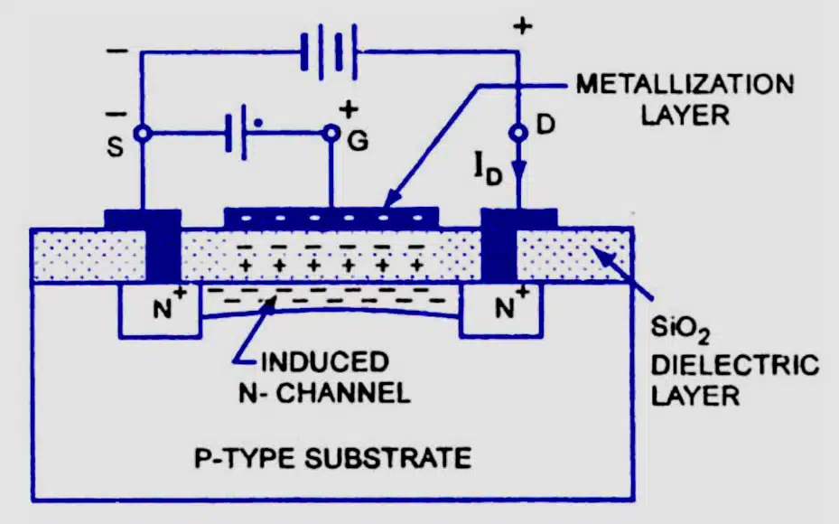
EEE 203
N-Channel Enhancement MOSFET
Page: 5

Slide 9
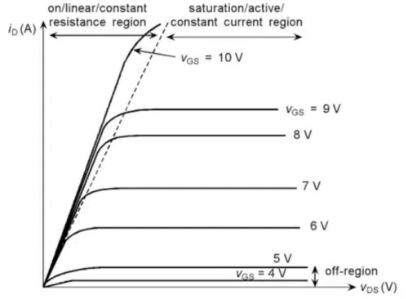
EEE 203
N-Channel Enhancement MOSFET V-I Characteristics

Slide 10
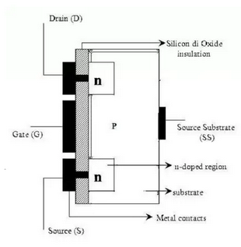
EEE 203
N- channel Depletion MOSFET:

Slide 11
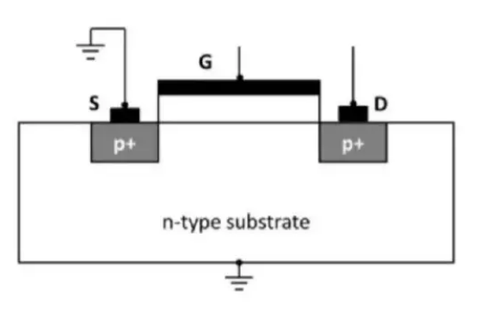
EEE 203
P-Channel Enhancement MOSFET

Slide 12
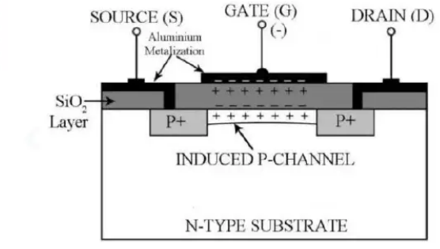
EEE 203
P-Channel Enhancement MOSFET

Slide 13
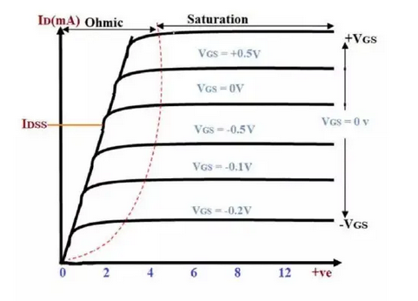
EEE 203
P-Channel Enhancement MOSFET V-I Characteristics

Slide 14
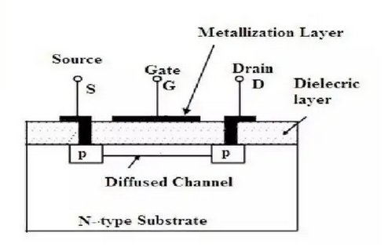
EEE 203
P-Channel Depletion MOSFET:

Slide 15
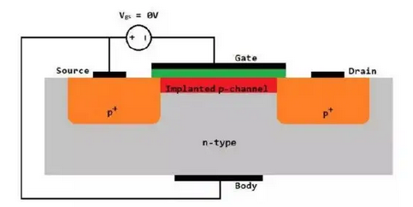
P-Channel Depletion MOSFET:
EEE 203

Slide 16
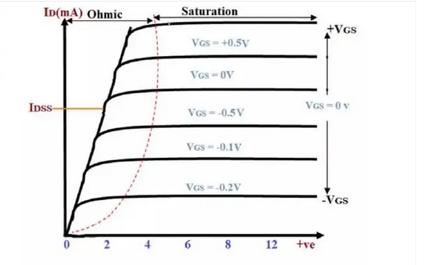
P-Channel Depletion MOSFET V-I Characteristics:
EEE 203

Slide 17
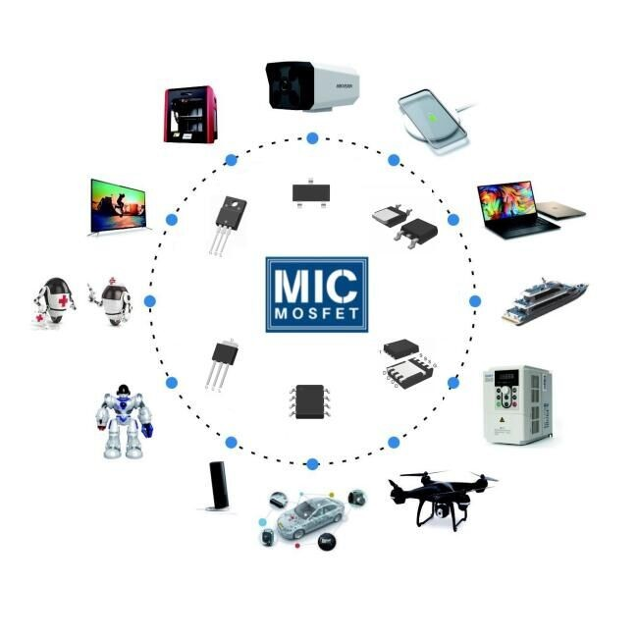
EEE 204
Applications of MOSFETs:
Microprocessors: MOSFETs are the basic building blocks of microprocessors, which are the brains of computers.
Memory chips: MOSFETs are used to store data in memory chips.
Logic circuits: MOSFETs are used to build logic circuits, which are used to perform calculations and make decisions.
Power electronics: MOSFETs can be used to switch high currents and voltages, making them useful in power electronics applications such as motor control and inverters.
Page: 4

Slide 18
EEE 203
Electronic Devices and Circuits & Pulse Tech
The End

